Slide 1
Lecture 17 Even more GUI programming
D&D 12

Slide 2
Goals
By the end of this lesson, you should:
Be able to write Java applications with menus.
Be able to write Java applications with JComboBoxes and JTextArea components
Be able to write Java applications that need to display and resize images displayed in JLabels
Have met anonymous inner classes and be able to use them to implement an alternative approach to event handling
Be able to open files with a JFileChooser

Slide 3
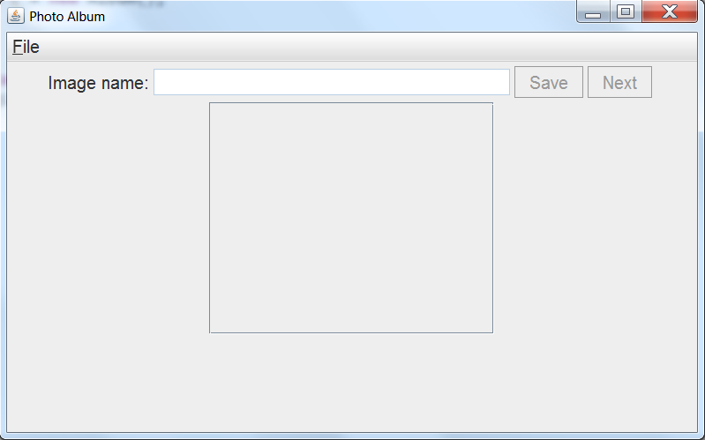
The Album application
The application
Startup
Imports
Overview
Constructor
Other methods
Event handling
Summary
JMenu
JMenuBar
JLabel
JButton
JTextField
JScrollPane (without visible content)

Slide 4
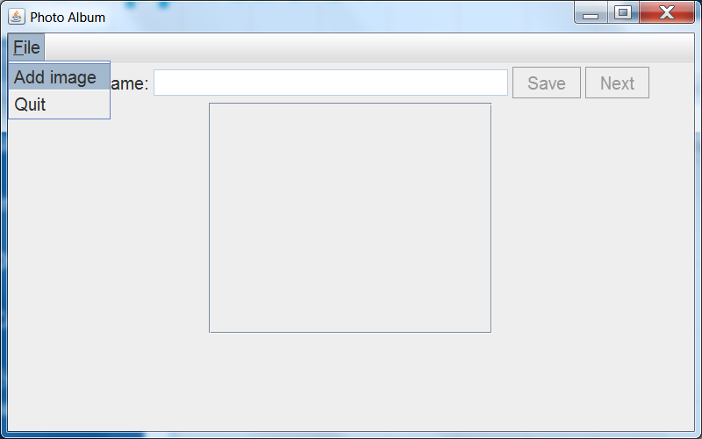
The Album application
The application
Startup
Imports
Overview
Constructor
Other methods
Event handling
Summary
JMenuItem

Slide 5
The Album application
The application
Startup
Imports
Overview
Constructor
Other methods
Event handling
Summary
JMenu
JMenuBar
JLabel
JButton
JTextField
JScrollPane (without visible content)

Slide 6
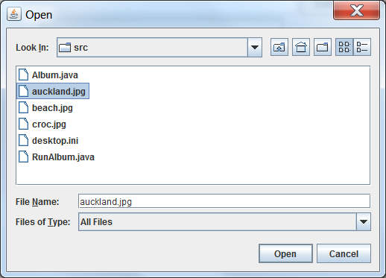
The Album application
The application
Startup
Imports
Overview
Constructor
Other methods
Event handling
Summary
JFileChooser

Slide 7
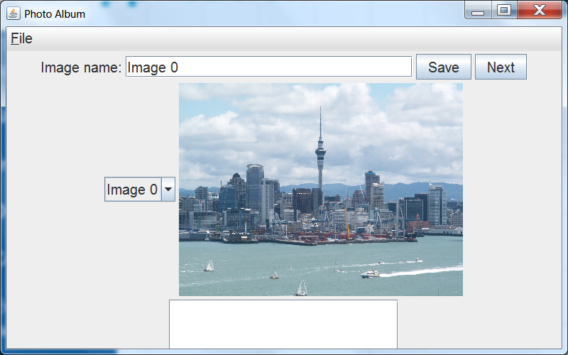
The Album application
The application
Startup
Imports
Overview
Constructor
Other methods
Event handling
Summary
The JTextField takes a name for the image.
Step through images
Save name and image caption
JLabel with
ImageIcon containing an Image
JComboBox with name for quick image selection
JTextArea in the JScrollPane for caption (image description)

Slide 8
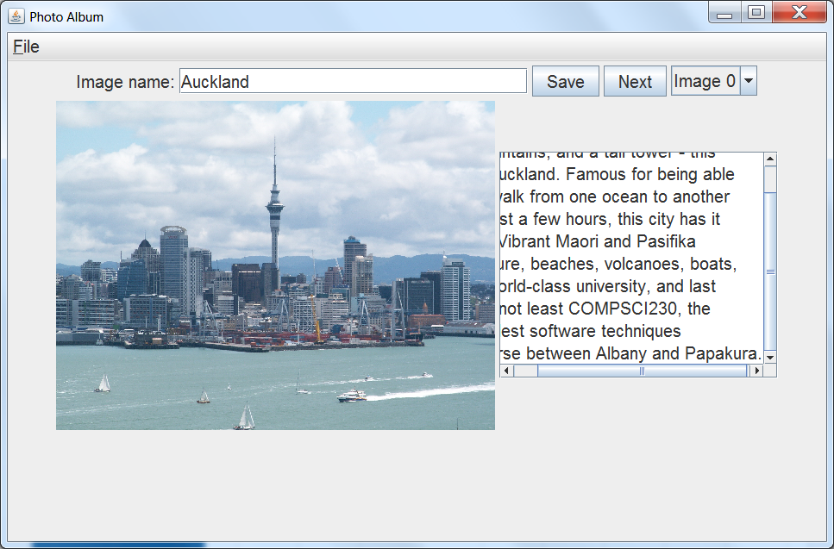
The Album application
The application
Startup
Imports
Overview
Constructor
Other methods
Event handling
Summary

Slide 9
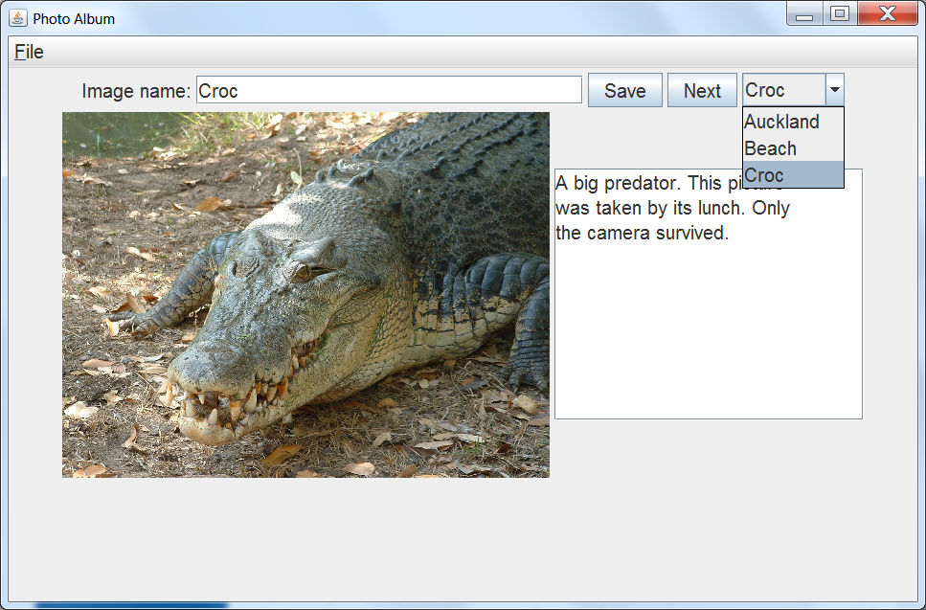
The Album application
The application
Startup
Imports
Overview
Constructor
Other methods
Event handling
Summary

Slide 10
Flow Layout quirks
The application
Startup
Imports
Overview
Constructor
Other methods
Event handling
Summary
Ugly positioning
Note how the JScrollPane
slips out of view when the combo box and image label become visible? More about that later…

Slide 11
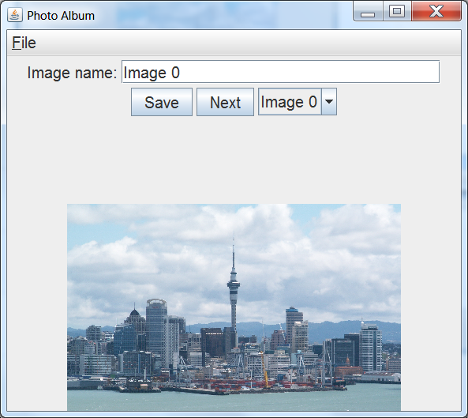
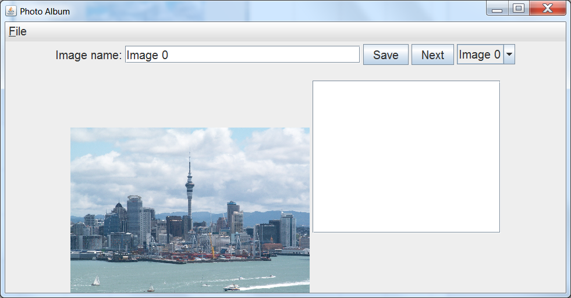
Resizing
The application
Startup
Imports
Overview
Constructor
Other methods
Event handling
Summary
Image rescales and layout adapts – but we get more quirkiness

Slide 12
Application startup
The application
Startup
Imports
Overview
Constructor
Other methods
Event handling
Summary
import javax.swing.SwingUtilities;
public class RunAlbum implements Runnable {
public void run() {
Album c = new Album();
}
public static void main(String[] args) {
SwingUtilities.invokeLater(new RunAlbum());
}
}
Once again the proper way of starting our Swing application to ensure it runs in the event dispatch thread.
Note the similarities to the RunListOWords class.

Slide 13
Imports in Album (1)
The application
Startup
Imports
Overview
Constructor
Other methods
Event handling
Summary
import java.util.ArrayList;
import java.awt.Dimension; // Needed for image handling
import java.awt.FlowLayout;
import java.awt.Font;
import java.awt.event.ActionEvent;
import java.awt.event.ActionListener;
import java.awt.Image;
import java.awt.event.ComponentEvent; // These two imports are
import java.awt.event.ComponentListener; // used in resizing.
import java.awt.event.ItemEvent; // These two imports are used
import java.awt.event.ItemListener; // with the JComboBox
import java.io.File; // This import lets us handle the image file
The number of imports in Album.java is a bit larger and comes from several sources. Some we’ve already seen, some are new. Here are the ones from java.util, java.awt, and java.io.

Slide 14
Imports in Album (2)
The application
Startup
Imports
Overview
Constructor
Other methods
Event handling
Summary
import javax.swing.JFrame;
import javax.swing.JTextField;
import javax.swing.JButton;
import javax.swing.JTextArea;
import javax.swing.JScrollPane;
import javax.swing.JComboBox;
import javax.swing.MutableComboBoxModel;
import javax.swing.DefaultComboBoxModel;
import javax.swing.ImageIcon;
import javax.swing.JMenuBar;
import javax.swing.JMenu;
import javax.swing.JMenuItem;
import javax.swing.JFileChooser;
import javax.swing.JLabel;
Here are the imports from javax.swing.
Note that for complex applications, you can also use wildcards:
import javax.swing.*;

Slide 15
The fields in Album
The application
Startup
Imports
Overview
Constructor
Other methods
Event handling
Summary
public class Album extends JFrame implements ComponentListener, ItemListener {
private ArrayList<Image> images;
private ArrayList<String> imageNames;
private ArrayList<String> captions;
private JComboBox<String> imagesComboBox;
private JLabel iconLabel;
private JLabel textFieldLabel;
private JTextField nameTextField;
private JButton saveButton;
private JButton nextButton;
private JTextArea captionTextArea;
private int currentImageIndex = -1;
private Font font; …
The fields correspond to the components we’ve identified on slide 3-6.
We also use three ArrayLists to store the original images and their names and captions.
currentImageIndex is the index of the currently displayed image in these ArrayLists.

Slide 16
The rest of the class
The application
Startup
Imports
Overview
Constructor
Other methods
Event handling
Summary
The constructor Album() once again sets up more or less the whole GUI.
However, here it does so with the help of a number of private methods. Their names start with setup…
The class also implements three other helper methods:
scaleImage() – returns a scaled version of the image passed to it.
setImage() – brings up the image that corresponds to a given index, and displays its name and caption. It also sets the combo box to show the image entry.
updateComboBox() – updates the image list in the combo box when we add an image or change an image name.
The class also implements the methods of the ComponentListener and ItemListener interfaces.

Slide 17
Album()
The application
Startup
Imports
Overview
Constructor
Other methods
Event handling
Summary
public Album() {
super("Photo Album");
setLayout(new FlowLayout());
setSize(800,500);
setDefaultCloseOperation(JFrame.EXIT_ON_CLOSE);
font = new Font("Sans-serif", Font.PLAIN, 20);
setupArrayLists();
setupMenu();
setupTextField();
setupSaveButton();
setupNextButton();
setupComboBox();
setupImageLabel();
setupTextArea();
this.addComponentListener(this);
setVisible(true);
}

Slide 18
setupArrayLists()
The application
Startup
Imports
Overview
Constructor
Other methods
Event handling
Summary
private void setupArrayLists() {
images = new ArrayList<Image>();
imageNames = new ArrayList<String>();
captions = new ArrayList<String>();
}
Homework:
Write a class called AlbumEntry that holds an image, a name and a caption, and reduce the number of ArrayLists to a single ArrayList<AlbumEntry>

Slide 19
setupMenu() (part 1)
The application
Startup
Imports
Overview
Constructor
Other methods
Event handling
Summary
private void setupMenu() {
JMenuBar menuBar = new JMenuBar();
setJMenuBar(menuBar);
JMenu fileMenu = new JMenu("File");
fileMenu.setMnemonic('F');
fileMenu.setFont(font);
menuBar.add(fileMenu);
JMenuItem fileMenuOpen = new JMenuItem("Add image");
fileMenuOpen.setFont(font);
…
setJMenuBar() is a method of JFrame and adds the menu bar to the frame. Note that we don’t use add() here as it isn’t a component that goes into the general frame area.
setMnemonic() sets the character for the keyboard shortcut.
menuBar acts like a container – so we add the menu to the menu bar, not the JFrame.
The entries in a menu are JMenuItems. Note that they don’t inherit the font from the menu.

Slide 20
setupMenu() (part 2)
The application
Startup
Imports
Overview
Constructor
Other methods
Event handling
Summary
fileMenuOpen.addActionListener(
new ActionListener()
{
public void actionPerformed(ActionEvent e) {
…
}
}
);
The ActionListener here uses a new concept that we haven’t seen before: an anonymous inner class. We instantiate this class with new by simply calling its constructor, which we declare on the spot.
So here, Java knows that it’s dealing with an ActionListener object, but note:
ActionListener isn’t a class – it’s an interface
All Java really needs to know here is that the anonymous class that’s being instantiated is of type ActionListener. Remember that interfaces are types, too.

Slide 21
The ActionListener
The application
Startup
Imports
Overview
Constructor
Other methods
Event handling
Summary
public void actionPerformed(ActionEvent e) {
JFileChooser fileChooser = new JFileChooser(".");
int retval = fileChooser.showOpenDialog(Album.this);
if (retval == JFileChooser.APPROVE_OPTION) {
File f = fileChooser.getSelectedFile();
// Create image icon from image file
ImageIcon newIcon = new ImageIcon(f.getAbsolutePath());
// Grab image in the image icon
Image iconImage = newIcon.getImage();
images.add(iconImage);
captions.add("");
currentImageIndex = images.size()-1;
imageNames.add("Image " + currentImageIndex);
// Replace image in icon with scaled version
newIcon.setImage(scaleImage(iconImage));
iconLabel.setIcon(newIcon);
updateComboBox();
nameTextField.setEnabled(true);
captionTextArea.setVisible(true);
captionTextArea.setEnabled(true);
saveButton.setEnabled(true);
nextButton.setEnabled(true);
}
}

Slide 22
What is happening here?
The application
Startup
Imports
Overview
Constructor
Other methods
Event handling
Summary
// Create file chooser for current directory:
JFileChooser fileChooser = new JFileChooser(".");
// Parameter of showOpenDialog references the Jframe
// and assists in positioning the dialog.
// Return value of showOpenDialog tells us whether
// the user chose a file or cancelled
int retval = fileChooser.showOpenDialog(Album.this);
if (retval == JFileChooser.APPROVE_OPTION) {
// The chooser can return a File object for our use File f = fileChooser.getSelectedFile();
Note that we need to use Album.this to refer to the this of the containing object (which is a Component). A plain this here would refer to the anonymous object that the code is part of. All the compiler known about this anonymous object is that it implements the ActionListener interface, but showOpenDialog() needs a Component.

Slide 23
setupMenu() (part 3)
The application
Startup
Imports
Overview
Constructor
Other methods
Event handling
Summary
fileMenu.add(fileMenuOpen);
JMenuItem fileMenuQuit = new JMenuItem("Quit");
fileMenuQuit.setFont(font);
fileMenu.add(fileMenuQuit);
fileMenuQuit.addActionListener(
new ActionListener()
{
public void actionPerformed(ActionEvent e) {
System.exit(0);
}
}
);
}
This is the final part of setupMenu()
The second menu item uses the same ActionListener implementation via anonymous inner class.
Note how we can get the application to close successfully when this menu item is chosen.

Slide 24
setupTextField()
The application
Startup
Imports
Overview
Constructor
Other methods
Event handling
Summary
private void setupTextField() {
textFieldLabel = new JLabel("Image name:");
textFieldLabel.setFont(font);
add(textFieldLabel);
nameTextField = new JTextField("",25);
nameTextField.setFont(font);
nameTextField.setEnabled(false);
add(nameTextField);
}
setupTextField() sets up the text input field for the name and the label that explains the field’s purpose to the user.
As the text field is initially useless (because we don’t have an image to name yet), we disable it. This is one way of doing so.
This is a common thing to do in applications as well as good practice – having enabled components before they are needed can confuse users.

Slide 25
setupSaveButton()
The application
Startup
Imports
Overview
Constructor
Other methods
Event handling
Summary
private void setupSaveButton() {
saveButton = new JButton("Save");
saveButton.setFont(font);
saveButton.setEnabled(false);
saveButton.addActionListener(
new ActionListener() {
public void actionPerformed(ActionEvent e) {
if (nameTextField.getText().length() > 0) {
imageNames.set(currentImageIndex,
nameTextField.getText());
captions.set(currentImageIndex,
captionTextArea.getText());
updateComboBox();
}
}
}
);
add(saveButton);
}
Not much new here: We learn that text areas also have a getText() method…

Slide 26
setupNextButton()
The application
Startup
Imports
Overview
Constructor
Other methods
Event handling
Summary
private void setupNextButton() {
nextButton = new JButton("Next");
nextButton.setFont(font);
nextButton.setEnabled(false);
nextButton.addActionListener(
new ActionListener() {
public void actionPerformed(ActionEvent e) {
currentImageIndex = ++currentImageIndex %
images.size();
setImage(currentImageIndex);
}
}
);
add(nextButton);
}
Note: Use of pre-increment and modulo operator. The latter allows us to cycle through the images

Slide 27
setupComboBox()
The application
Startup
Imports
Overview
Constructor
Other methods
Event handling
Summary
private void setupComboBox() {
imagesComboBox = new JComboBox<String>();
imagesComboBox.setModel((MutableComboBoxModel) new DefaultComboBoxModel());
imagesComboBox.setMaximumRowCount(8);
imagesComboBox.addItemListener(this);
imagesComboBox.setFont(font);
imagesComboBox.setMinimumSize(new Dimension(300,25));
imagesComboBox.setVisible(false);
add(imagesComboBox);
}
Note: Use of pre-increment and modulo operator. The latter allows us to cycle through the images.
Setting the model allows us to make changes to the item list later.
The maximum row count isn’t a limit on the possible number of items in the list – it limits the number of items that the combo box displays simultaneously. This prevents the bottom of the combo box from disappearing at the bottom of the screen.

Slide 28
setupImageLabel()
The application
Startup
Imports
Overview
Constructor
Other methods
Event handling
Summary
private void setupImageLabel() {
iconLabel = new JLabel();
add(iconLabel);
}
We display the image as an icon on a standard JLabel.

Slide 29
setupTextArea()
The application
Startup
Imports
Overview
Constructor
Other methods
Event handling
Summary
private void setupTextArea() {
captionTextArea = new JTextArea("", 10, 20);
captionTextArea.setFont(font);
captionTextArea.setVisible(false);
captionTextArea.disable(); // alternative to setEnabled(false)
add(new JScrollPane(captionTextArea));
}
The text area also needs to be disabled at first until we have loaded our first image. Here, we use the disable() method. It has a counterpart called enable(). We’re also hiding it completely with setVisible().
Note again the use of the JScrollPane to make the caption scrollable.

Slide 30
scaleImage()
The application
Startup
Imports
Overview
Constructor
Other methods
Event handling
Summary
private Image scaleImage(Image img) {
return img.getScaledInstance(getHeight() *
3 *img.getWidth(null)
/(5*img.getHeight(null)),
3*getHeight()/5,
Image.SCALE_FAST);
}
This method scales an image so it takes 3/5th of the height of the JFrame while keeping the aspect ratio constant.
Note that getHeight() gives us the height of the JFrame, whereas img.getHeight() gives us the height of the image. These are two totally different things!
The aspect ratio is the ratio between height and width of an image. In our case, that’s img.getWidth()/img.getHeight().
Image.SCALE_FAST tells Java which algorithm to use for scaling.

Slide 31
Scaling images
The application
Startup
Imports
Overview
Constructor
Other methods
Event handling
Summary
Scaling an image is a trade-off between quality and speed.
The fastest scaling by a factor of n involves either:
Picking every n’th pixel only in each dimension when we’re scaling down. This can make the smaller image appear noisy because the pixels we pick may not be representative for their surrounding pixels.
Copying each pixel as an n-by-n pixel block when we are scaling up. This makes the larger image look “tiled”.
Better quality scaling can be achieved by:
Computing a representative pixel value for each n-by-n pixel block when scaling down.
Computing interpolated pixel values for the extra pixels in a scaled-up image.
This extra computation takes a lot of extra time – time we don’t necessarily have when trying to render our JFrame with a scaled image after a window resize.

Slide 32
setImage()
The application
Startup
Imports
Overview
Constructor
Other methods
Event handling
Summary
private void setImage(int imageIndex) {
Image img = scaleImage(images.get(imageIndex));
if (img != null) {
((ImageIcon) (iconLabel.getIcon())).setImage(img);
iconLabel.repaint();
if (imageNames.size() > imageIndex) {
nameTextField.setText(imageNames.get(imageIndex));
}
if (captions.size() > imageIndex) {
captionTextArea.setText(captions.get(imageIndex));
}
imagesComboBox.setSelectedIndex(imageIndex);
}
}
This method switches to a given image. Both the Next button and the combo box use this method.
Homework: This method doesn’t work quite as it should. Can you spot (and fix) the problem?

Slide 33
updateComboBox()
The application
Startup
Imports
Overview
Constructor
Other methods
Event handling
Summary
private void updateComboBox() {
imagesComboBox.removeAllItems();
for (String imageName : imageNames) {
imagesComboBox.addItem(imageName);
}
imagesComboBox.setSelectedIndex(currentImageIndex);
imagesComboBox.setVisible(true);
}
We update the JComboBox with a new list of items by removing all existing items and adding the new items afterwards.

Slide 34
ComponentListener
The application
Startup
Imports
Overview
Constructor
Other methods
Event handling
Summary
public void componentResized(ComponentEvent e) {
if (currentImageIndex >= 0) {
Image img = images.get(currentImageIndex);
ImageIcon icon = new ImageIcon();
icon.setImage(scaleImage(img));
iconLabel.setIcon(icon);
}
iconLabel.setSize(this.getSize());
this.repaint();
}
The componentResized() method handles the frame resize and ensure that our label image is replaced with an appropriately sized image and that the JFrame gets repainted.
All other method implementations for the ComponentListener interface just return void but don’t do anything else. However, because the class declaration says that the class implements this interface, we must implement these methods – even if they may never get called.

Slide 35
ItemListener
The application
Startup
Imports
Overview
Constructor
Other methods
Event handling
Summary
public void itemStateChanged(ItemEvent e) {
if (e.getStateChange() == ItemEvent.SELECTED) {
setImage(imagesComboBox.getSelectedIndex());
}
return;
}
The ItemListener interface consists of a single method.
We need to query the event itself to see what triggered it – in this case, it will be the act of selecting an item in our JComboBox.

Slide 36
What do we know
The application
Startup
Imports
Overview
Constructor
Other methods
Event handling
Summary
We can build a GUI step by step.
Using anonymous inner classes is a powerful way of implementing a large number of different event handlers with the same interface.
We can select files with a JFileChooser and get a File object encapsulating various properties of the file, e.g., its path.
We can display images with JLabels and manipulate the underlying Image object.
We know how to configure, populate and chance JComboBoxes
We can handle ComponentEvents and ItemEvents.
We can hide and show components, and enable and disable them.
Just using a FlowLayout doesn’t work overly well for larger GUIs

Slide 37
Resources & Homework
The application
Startup
Imports
Overview
Constructor
Other methods
Event handling
Summary
D&D Chapter 12
https://docs.oracle.com/javase/tutorial/uiswing/components/combobox.html
https://docs.oracle.com/javase/8/docs/api/java/awt/Image.html
https://docs.oracle.com/javase/8/docs/api/javax/swing/ImageIcon.html
https://docs.oracle.com/javase/8/docs/api/javax/swing/JFileChooser.html
… or just google the component, class or interface of interest
Homework: See slides 18 and 32. Also: Can you change the JComboBox ItemListener to an anonymous inner class?

Slide 38
Next Lecture
Yet more GUI programming (Chapter 12)

